Slide 1
TRAFFIC SIGN RECOGNITION
Jose Pablo Cereceda Meca
Diego Martin Crespo
CS512 - Fall 2018

Slide 2
INTRODUCTION

Slide 3
Introduction
Motivation
Reference → Traffic Sign Recognition for Computer Vision Project-Based Learning
Dataset → KUL Belgium traffic signs and classification benchmark datasets

Slide 4
APPROACH

Slide 5
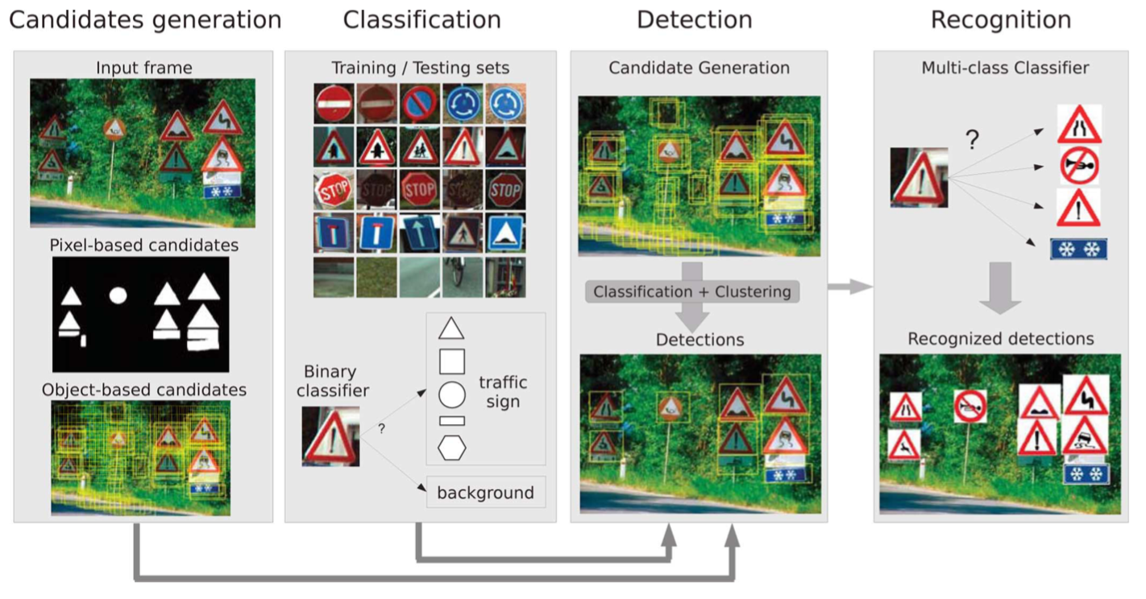
Approach (I)

Slide 6
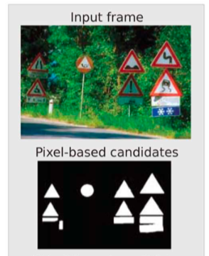
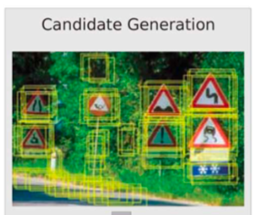
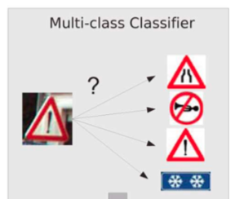
Approach (II)
Image Preprocessing
Detection
Classification

Slide 7
IMPLEMENTATION

Slide 8
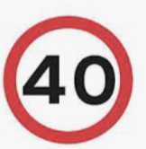












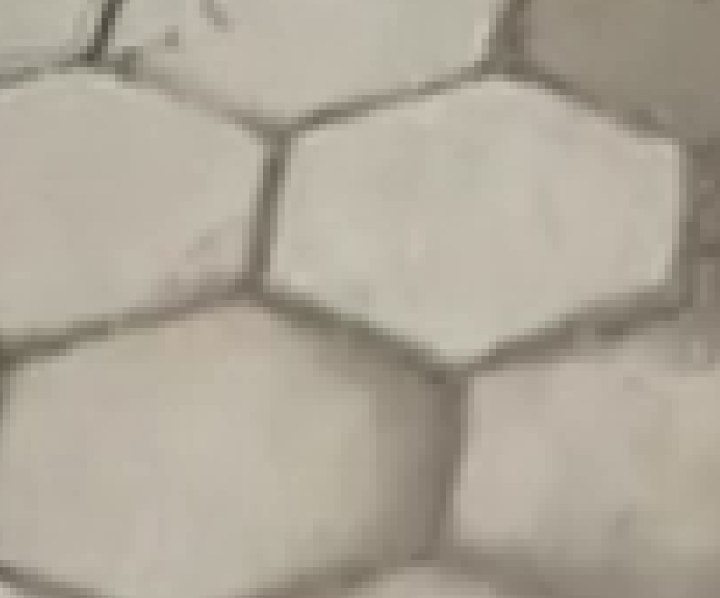
Image Data Modeling
Linköpings University traffic sign dataset
STEPS:
Definition of 14 classes → 13 traffic signs and 1 error class
Cleaning the dataset→ removing bad images with high noise

Slide 9
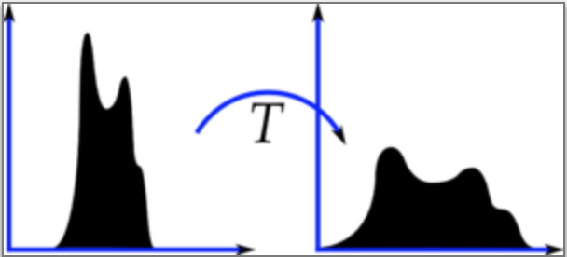
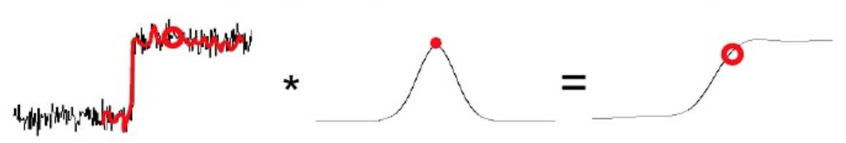
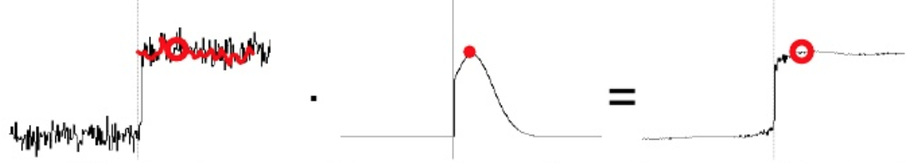
Image Preprocessing
Three main steps:
Contrast limit
Edge detection
Binary
Gaussian
Bilateral

Slide 10
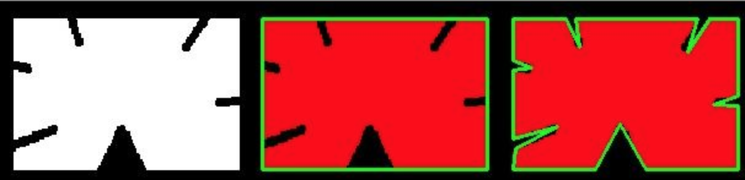
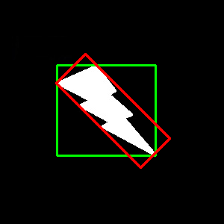
Sign Detection
Steps:
Remove small components
Find contours
Detect sign shapes
Select largest contour
Crop image

Slide 11
Image Classification
STEPS:
Loading Data Images
SVM class definition
Get HOG descriptors
Deskew images
Training Process
Testing Process

Slide 12
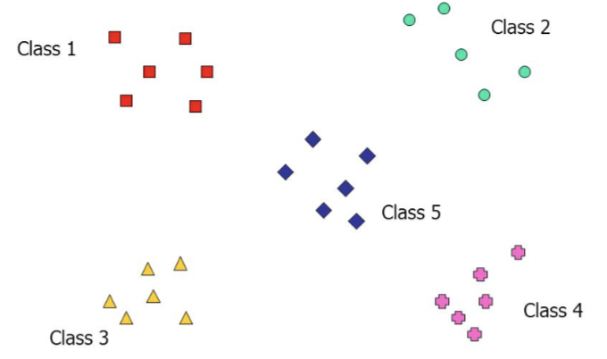
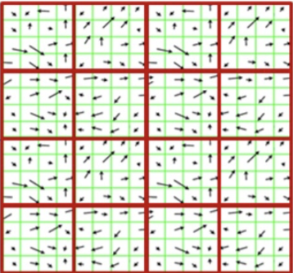
Image Classification II
SVM
HOG
Class definition with 4 different functions for initialise the model, train it, save it and predict
Algorithm implementation steps:
Gradient Computation
Orientation binning
Descriptor Blocks
Block Normalization
Object Recognition
ADVANTAGES:
High accuracy, high flexibility
Naturally handle large dimensional data
Sparse representation of the solutions

Slide 13
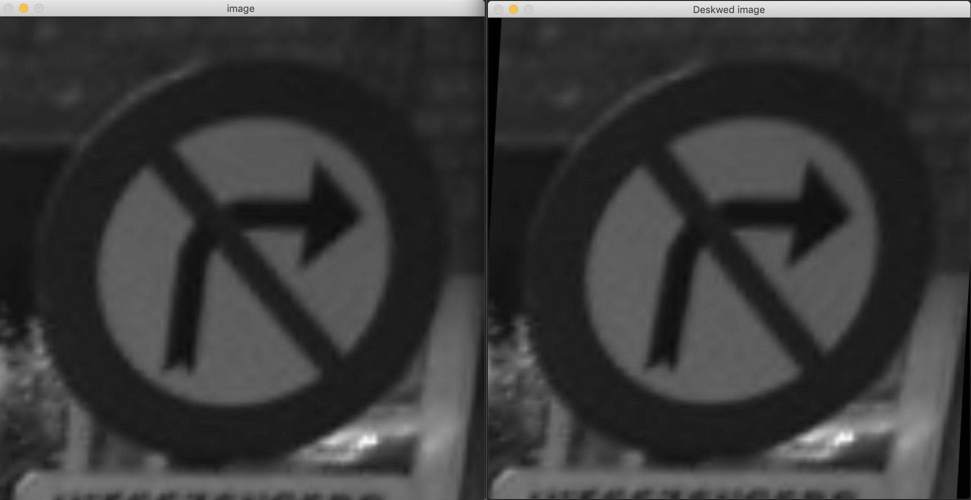
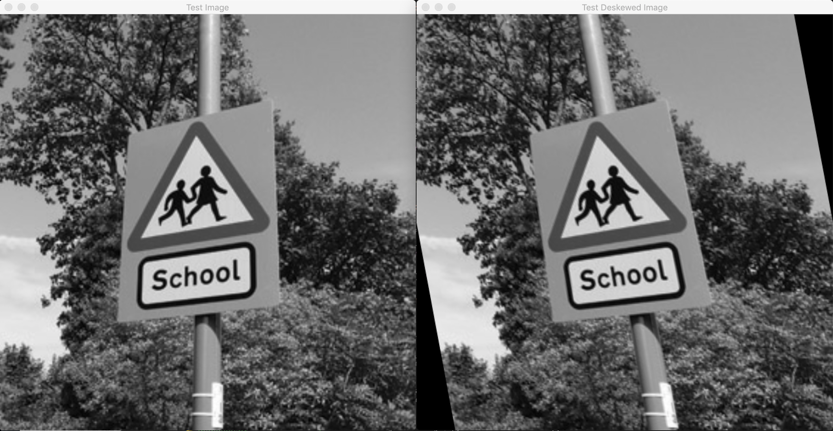
Image Classification III
Deskew
Training and Testing
90% TRAINING
10% TEST
Get Label
14 LABELS
13 TRAFFIC SIGNS
1 ERROR LABEL

Slide 14
RESULTS

Slide 15
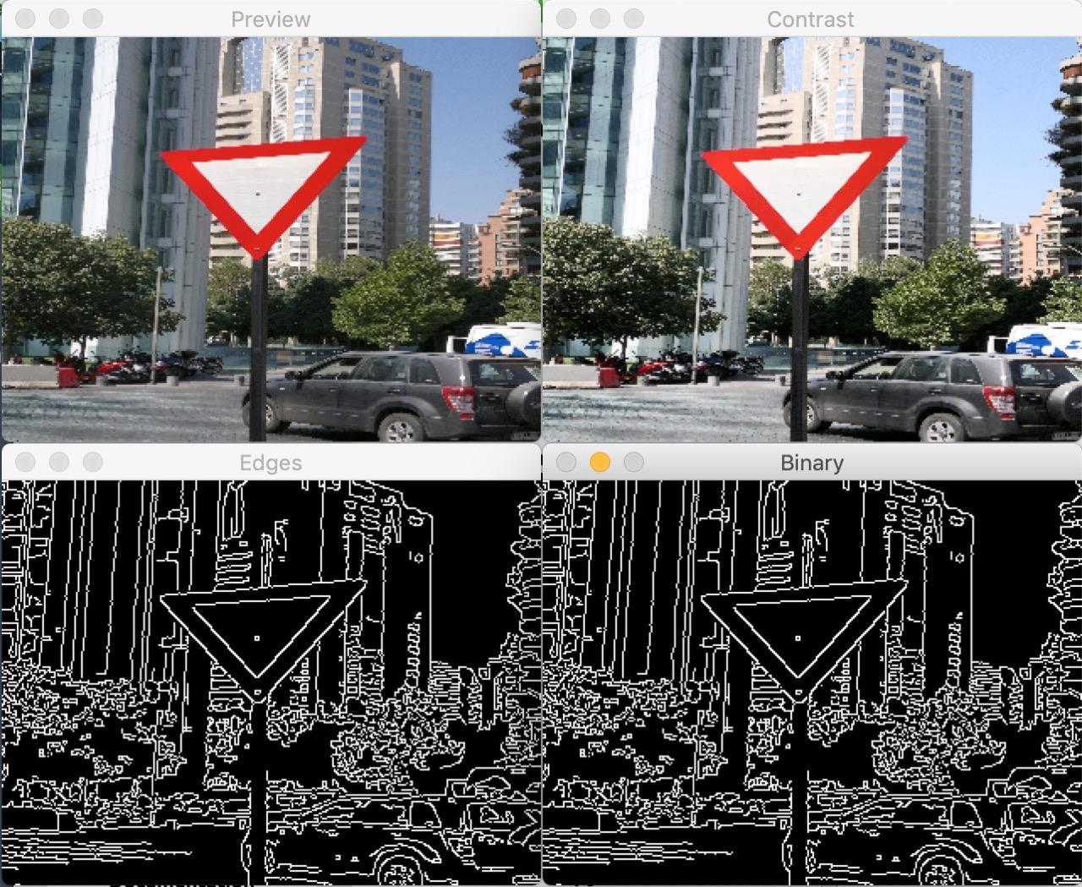
Image Preprocessing

Slide 16
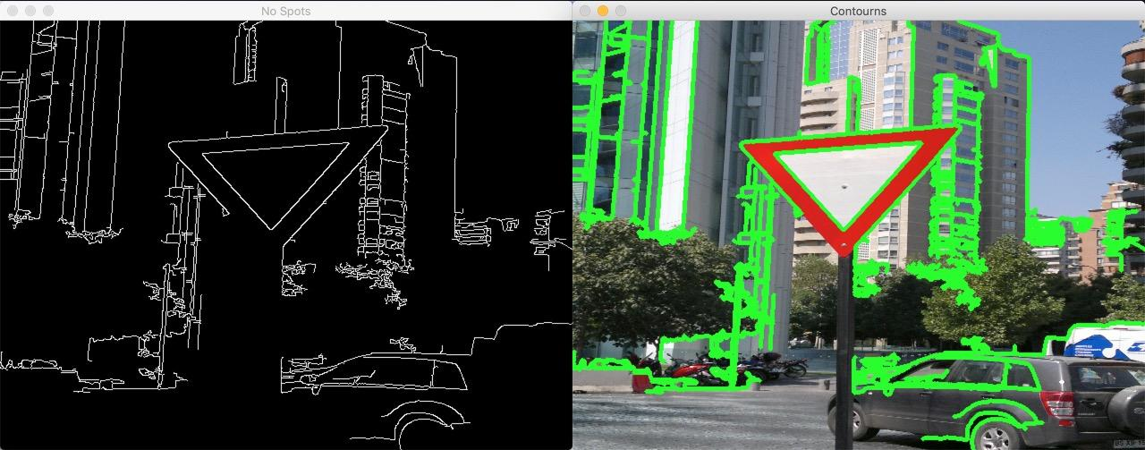
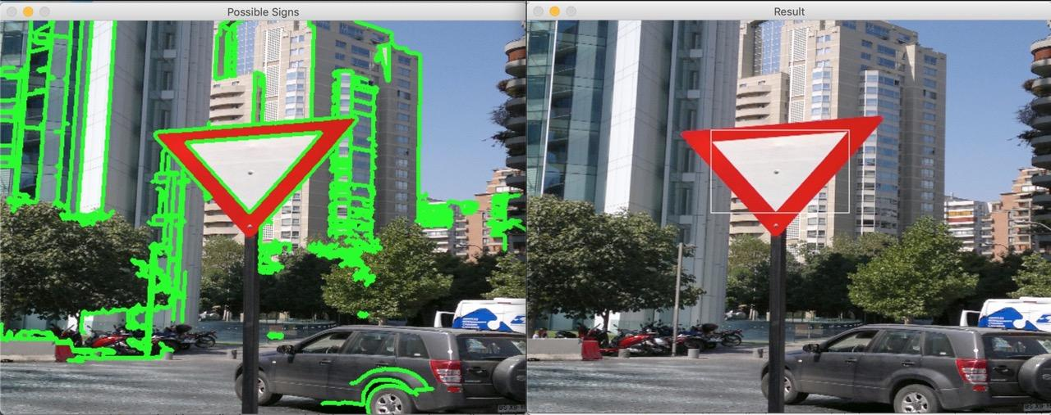
Sign Detection (I)

Slide 17
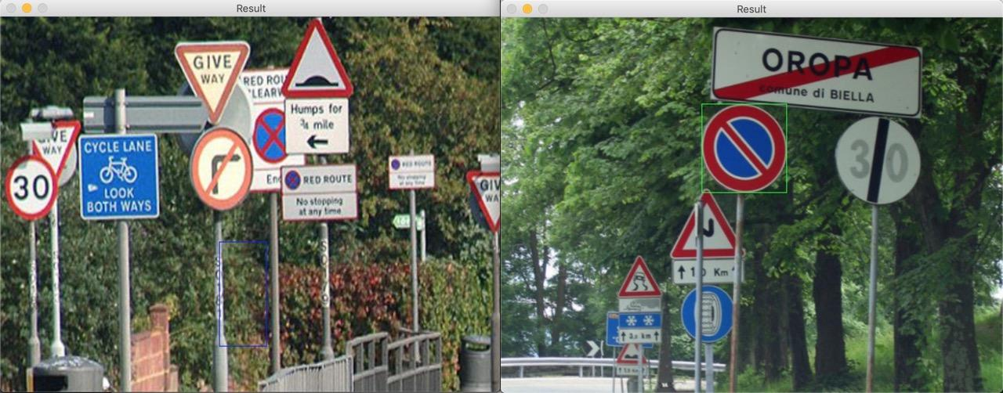
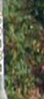
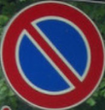
Sign Detection (II)

Slide 18
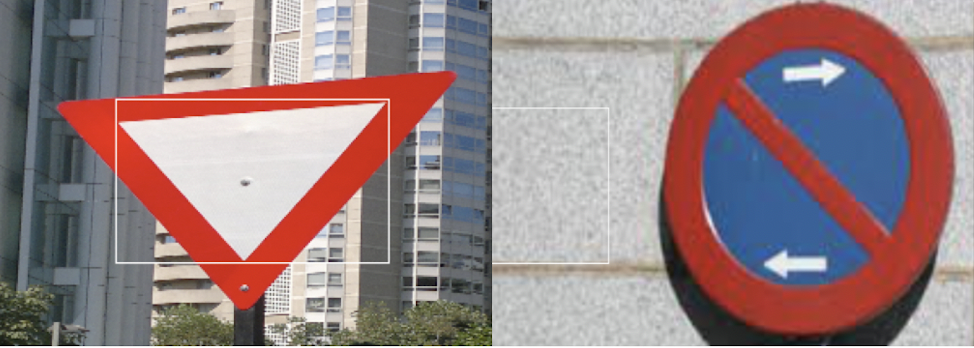
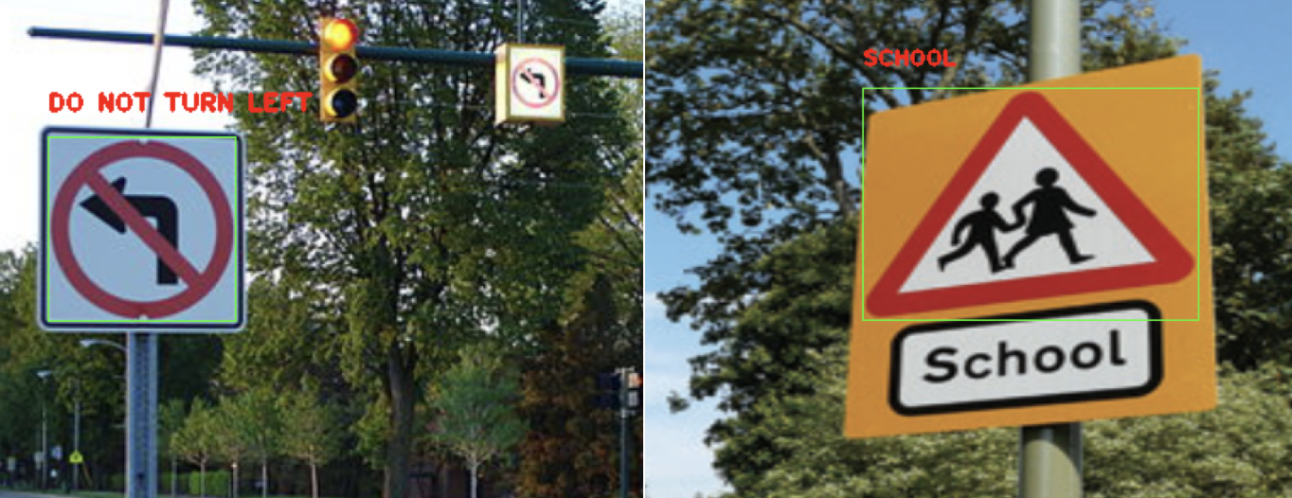
Image Classification
BAD CLASSIFICATION
GOOD CLASSIFICATION

Slide 19
Image Classification II
Modifying the following parameters:
MAX-NUMBER of images per traffic sign type equal to 80
HOG parameters: lower down to 5 bins
Accuracy of 93.52%

Slide 20
CONCLUSION & FUTURE IMPROVEMENTS

Slide 21
Conclusion
Future improvements
Use a CNN as a classifier
Sign detection by top-down sliding windows algorithm
Video support
Good learning experience
Program susceptible to improvements in every phase.

Slide 22
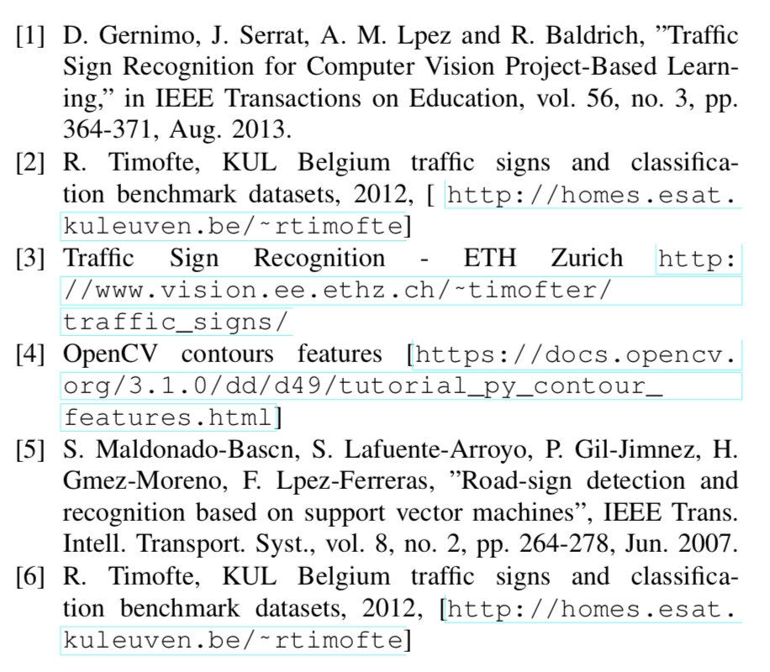
References

